Slide 1














INNOVATION IN IT
Presented by Paul Cheneget Ndege
Reg No: C025-01-1262/2019

Slide 2

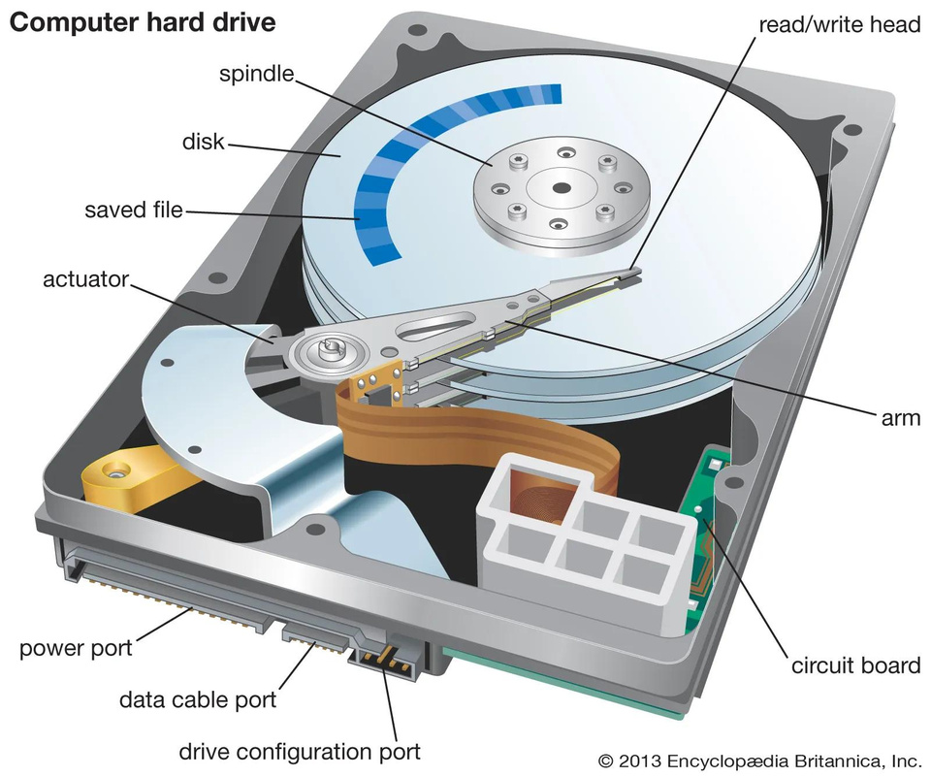
INTRODUCTION
Definition of Hard Disk Drives (HDDs): HDDs are traditional storage devices that use magnetic platters and read/write heads to store and retrieve data.
How HDDs Work: HDDs store data magnetically on spinning disks. The read/write heads move across the platters to access and modify data.
Limitations of HDDs: HDDs are relatively slow compared to SSDs due to mechanical parts, prone to failure, larger in physical size, and consume more power.

Slide 3
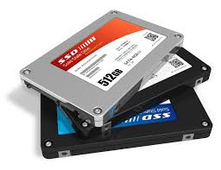
Introduction to Solid State Drives (SSDs)
Definition of Solid State Drives (SSDs): SSDs are storage devices that use flash memory chips and a controller to store and retrieve data.
How SSDs Work: SSDs use NAND flash memory chips to store data. They have no moving parts, resulting in faster read/write speeds and improved reliability.
Advantages of SSDs over HDDs: SSDs offer faster performance, lower latency, increased reliability, smaller physical size, and lower power consumption compared to HDDs.

Slide 4
Evolution of SSD Technology
Timeline of SSD Development and Evolution:
Introduction of NAND Flash Memory
Development of SATA Interface
Adoption of PCIe Interface for Increased Speeds
Advancements in 3D NAND Technology
Milestones in SSD Technology Advancement: Each milestone contributed to faster speeds, higher capacities, and improved reliability of SSDs.

Slide 5
Key Features and Benefits of SSDs
Faster Read/Write Speeds: SSDs offer significantly faster data transfer rates compared to HDDs, resulting in quicker boot times and application loading.
Lower Latency and Access Time: SSDs have virtually no seek time, reducing the delay in accessing data.
Improved Reliability and Durability: SSDs have no moving parts, making them less prone to mechanical failure and better suited for rugged environments.
Compact Size and Form Factor: SSDs are available in various form factors, including M.2, PCIe, and SATA, allowing for flexible installation in a variety of devices.
Reduced Power Consumption: SSDs consume less power than HDDs, making them ideal for mobile devices and energy-efficient data centers.

Slide 6
Applications of SSDs in Information Technology
Personal Computing: SSDs are commonly used in laptops and desktops to improve system responsiveness and overall performance.
Enterprise Storage Solutions: SSDs are deployed in servers and data centers to accelerate data access, reduce latency, and improve overall efficiency.
Consumer Electronics: SSDs are integrated into smartphones, tablets, and digital cameras to enhance storage capacity and performance.
Industrial and Embedded Systems: SSDs are utilized in industrial applications and embedded systems where reliability and durability are critical.

Slide 7
Future Trends and Innovations in SSD Technology
Discussion on Emerging Technologies:
3D NAND: Vertical stacking of NAND cells to increase storage density and reduce manufacturing costs.
NVMe (Non-Volatile Memory Express): Protocol designed for SSDs to leverage the full potential of PCIe interface, enabling even faster data transfer rates.
QLC Flash: Quad-Level Cell Flash technology increases storage capacities while maintaining performance and reliability.
Potential Applications and Use Cases: Emerging SSD technologies are poised to revolutionize various industries, including artificial intelligence, Internet of Things, and edge computing.

Slide 8
Challenges and Limitations of SSDs
Cost: SSDs tend to have higher upfront costs compared to HDDs, although prices have been steadily declining.
Endurance and Longevity: NAND flash memory has a limited number of write cycles, which can affect the lifespan of SSDs, especially under heavy workloads.
Compatibility Issues: Legacy systems may not fully support SSD technology, requiring additional hardware or software upgrades for integration.

Slide 9
Conclusion
Recap of Key Points: SSDs offer significant advantages over HDDs, including faster performance, improved reliability, and reduced power consumption.
Importance of SSDs in Advancing Information Technology: SSDs play a crucial role in enabling faster data processing, enhancing system efficiency, and driving innovation across various industries.
Future Outlook and Potential Impact: Continued advancements in SSD technology are expected to further accelerate the adoption of SSDs and unlock new possibilities in data storage and computing.

Slide 10
Thank you very much!
Paul Cheneget Ndege

